Slide 1
First & Second SDG Action Plan for SID-A Comparative Analysis
Presented by
Farhana Sultana
Deputy Director
SDG Cell
Statistics and Informatics Division

Slide 2
Action for Implementation
In 2018, the first SDGs Action Plan was prepared by aligning the 7th Five-Year plan under the umbrella of “National Action Plan of Ministries/Divisions by Targets for the Implementation of SDGs”.
The Government assigned specific duties to 43 Ministries/Divisions depending on the allocation of business, designating them as lead, co-lead, or associate implementers of the SDGs targets.
2nd Action Plan has been aligned with the 8th Five Year Plan expected to expedite the SDG-based progress in a more organized way to achieve the targets by 2030.
In this connection, the National SDG Action Plan will guide us to develop a comprehensive development approach, implement the projects/programmes in a coordinated manner, and build a society where everyone will get benefit from economic development.

Slide 3
Mapping of Ministries/Divisions by SDGs
GED published the mapping of Ministries/Divisions by SDG targets in 2016.
This first formal document on the SDGs implementation reflects well-thought-out efforts by the GoB in delineating responsibilities by the Ministries/Divisions to each of the SDG targets.
GED has reviewed and revised the report.
The Hon’ble Prime Minister H.E. Sheikh Hasina unveiled the revised mapping report at the Second National Conference on SDGs IMPLEMENTATION REVIEW (SIR) 2022.

Slide 4
SID in Revised Mapping
Targets and Indicators | Lead and Co-Lead Ministry/ Division | Associate Ministry/ Division | Data Sources | Custodian and Partner Agency
Data, monitoring and accountability
17.18 By 2020, enhance capacity-building support to developing countries, including for least developed countries and small island developing States, to increase significantly the availability of high-quality, timely and reliable data disaggregated by income, gender, age, race, ethnicity, migratory status, disability, geographic location and other characteristics relevant in national contexts Lead: SID (BBS)
17.18.1 Statistical capacity indicator for Sustainable Development Goal monitoring | Lead: SID (BBS) | BB; ERD; FD; IRD; SHED; TMED; MoPME; MoEFCC; HSD; MEFWD; EMRD; ICTD; PTD; LGD; MoA; MoFood; MoCHTA; SSD; MoPA; MoWCA; MoEWOE; MoHPW; MoFA; MoFL; GED | a) SID (SDG Cell) | World Bank, All UN Custodian Agencies
17.18.2 Number of countries that have national statistical legislation that complies with the Fundamental Principles of Official Statistics | Lead: SID (BBS) | BB; ERD; FD; IRD; SHED; TMED; MoPME; MoEFCC; HSD; MEFWD; EMRD; ICTD; PTD; LGD; MoA; MoFood; MoCHTA; SSD; MoPA; MoWCA; MoEWOE; MoHPW; MoFA; MoFL; GED | a) SID (SDG Cell) | CA: PARIS21 (All UN Custodian Agencies)
17.18.3 Number of countries with a national statistical plan that is fully funded and under implementation, by source of funding | Lead: SID (BBS) | BB; ERD; FD; IRD; SHED; TMED; MoPME; MoEFCC; HSD; MEFWD; EMRD; ICTD; PTD; LGD; MoA; MoFood; MoCHTA; SSD; MoPA; MoWCA; MoEWOE; MoHPW; MoFA; GED | a) SID (SDG Cell) | CA: PARIS21 PA: UNSD, Regional Commissions, World Bank

Slide 5
SID in Revised Mapping (Contd.)
Targets and Indicators | Lead and Co-Lead Ministry/ Division | Associate Ministry/ Division | Data Sources | Custodian and Partner Agency
17.19 By 2030, build on existing initiatives to develop measurements of progress on sustainable development that complement gross domestic product, and support statistical capacity-building in developing countries Lead: SID
17.19.1 Dollar value of all resources made available to strengthen statistical capacity in developing countries | Lead: SID | GED; FD; ERD; BB | a) ERD b) SID (SDG Cell) | CA: PARIS21 PA: UNSD, Regional Commissions, World Bank
17.19.2 Proportion of countries that (a) have conducted at least one population and housing census in the last 10 years; and (b) have achieved 100 per cent birth registration and 80 per cent death registration | Lead: SID Co-lead: LGD |  | a) BBS (Census Wing), SID b) ORG, LGD | CA: UNSD PA: UNFPA, DESA Population Division, other involved agencies in the inter-agency group on CRVS, UNDP
SID has also identified as a new Co-Lead (8.1.1, 10.4.2, 12.b) and Associate (11.3.1)in the revised mapping.

Slide 6
National SDG Action Plan
Both Action Plan (1st & 2nd) has been prepared and published by GED by compiling actions of 43 Ministries/Divisions.
A comprehensive set of actions for Ministries/Divisions by SDG targets following the mapping exercise.
This action plan has worked as an effective instrument for undertaking development actions (Projects/Programs) required for the implementation of SDGs in Bangladesh.

Slide 7
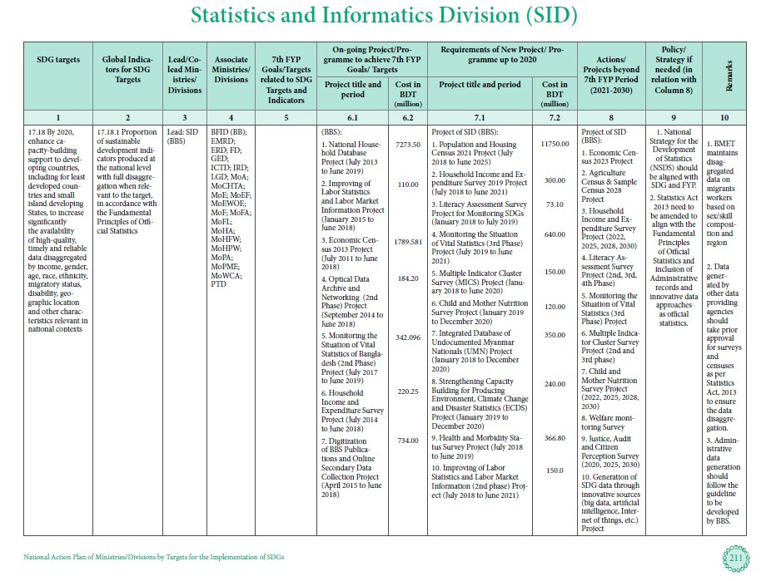
SID in 1st SDG Action Plan

Slide 8
SID SDG Action Plan Review Highlights
As National Statistics Office (NSO), BBS of SID is engaged with all the goals, 83 targets and 105 indicators, SID is lead for 02 targets and associated 04 indicators.
SID and BBS together are responsible for providing the data against 109 (BBS 105+ SID 04) indicators .
As a Lead (SDG targets 17.18 and 17.19), SID proposed 30 projects/programs (ongoing 14 + new 16) in the First SDG Action Plan.

Slide 9
SID in 2nd SDG Action Plan

Slide 10
SID SDG 2nd Action Plan Review Highlights
As National Statistics Office (NSO), BBS of SID is engaged with all the goals, 83 targets and 111 indicators, SID is lead for 02 targets and associated 04 indicators.
SID and BBS together are responsible for providing the data against 115 (BBS 111+ SID 04) indicators .
As a Lead (SDG targets 17.18 and 17.19), SID proposed 34 projects/programs (ongoing 12 + new 16) in the 2nd SDG Action Plan. Among them, SID completed 06 projects/programs.
As a new Co-Lead (12.b) in revised mapping, development actions have been taken from SID in the Second SDG Action Plan.
Initiative has been taken to align the 2nd National Strategy for the Development of Statistics (NSDS) with SDGs.

Slide 11
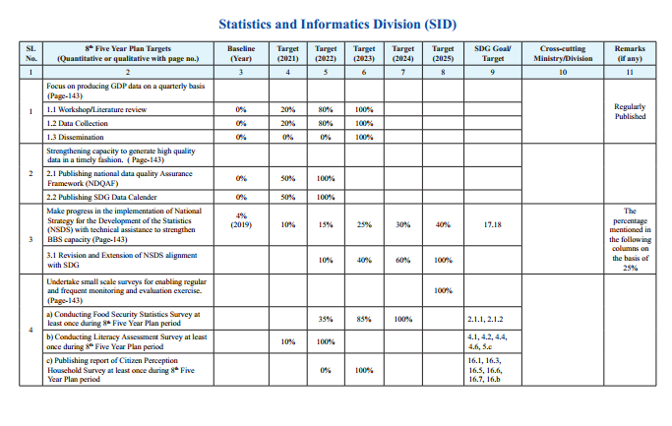
8FYP Targets for SID

Slide 12
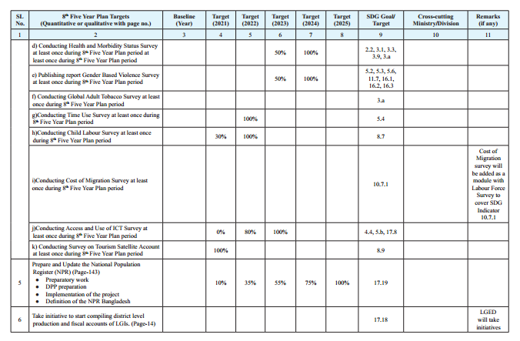
8FYP Targets for SID (Contd.)

Slide 13
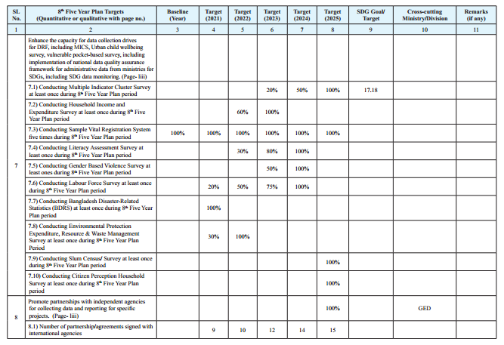
8FYP Targets for SID (Contd.)

Slide 14
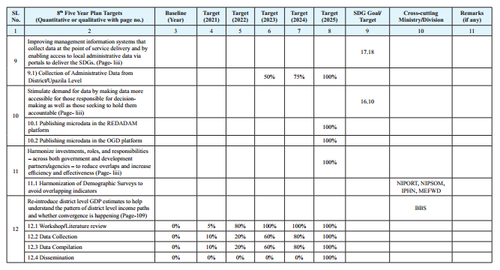
8FYP Targets for SID (Contd.)

Slide 15
Difference between 1st & 2nd SDG National Action plan
SL. |  | 1st SDG National Action plan | 2nd SDG National Action plan
01. | Implementation period | 1st Action Plan was implemented during 2016-2020 aligning with the 7th Five Year Plan. | 2nd SDG National Action Plan’s implementation period is July 2020-June 2025 aligning with the 8th Five Year Plan.
02. | Adapting year | In 2018, following the first mapping exercise by GED. | In may 2023, following the revised mapping exercise by GED
03. | Alignment level | In the 1st Action Plan, alignment level was up to the SDGs targets. | In the 2nd Action Plan, all the targets of 8th Five-Year Plan has been aligned properly with the indicators of SDGs.
04. | Number of Projects/Programs/Activities | As a Lead (SDG targets 17.18 and 17.19), SID proposed 30 projects/programs/Activities in the First SDG Action Plan. | As a Lead (SDG targets 17.18 and 17.19) & new Co-Lead of 12.b , SID proposed 34 projects/programs (ongoing 12 + new 16) in the 2nd SDG Action Plan. Among them, SID completed 06 projects/programs.

Slide 16
Ongoing Projects/Programs/Activities
SL | Name of projects | Source of SDG indicators
01. | Population and Housing Census 2021 Project . | 1.4.1, 3.1.1, 3.2.1, 3.2.2, 3.7.2, 4.2.2, 4.3.1, 5.3.1, 5.b.1, 6.2.1, 7.1.1, 7.1.2, 8.5.2, 8.7.1, 8.10.2,9.1.1, 9.5.2, 11.1.1, 11.2.1, 17.8.1, 17.19.2 = 20
02. | Household Income and Expenditure Survey (HIES) 2020-2021 Project. | 1.1.1, 1.2.1, 1.3.1, 1.4.1*, 1.b.1, 2.1.1, 3.8.2, 4.1.2, 5.b.1, 8.10.2, 10.1.1, 10.2.1, 10.4.2, 17.8.1= 14
03. | Sample Vital Registration System in Digital Platform Project (SVRS). | 1.2.2, 1.4.1, 2.1.2, 3.1.1, 3.1.2, 3.2.1, 3.2.2, 3.4.1, 3.6.1, 3.7.1, 3.7.2, 3.8.1, 3.9.1, 3.9.2, 4.1.2, 4.2.2, 4.3.1, 4.4.1, 5.3.1, 5.b.1, 6.1.1**, 6.2.1, 7.1.1, 7.1.2, 8.10.2, 16.9.1, 17.8.1=27
04. | Improving Labor Market Information through Labor Force survey Project. | 5.4.1, 5.5.2, 5.b.1, 8.2.1, 8.3.1, 8.5.1, 8.5.2, 8.6.1, 8.7.1, 8.8.1, 9.2.2, 9.5.2 =12
05. | Violence Against Women (VAW) Survey (2023-2025). | 5.2.1, 5.2.2, 5.3.1, 5.6.1, 11.7.2, 16.1.3, 16.2.1, 16.2.3, 16.3.1 =09

Slide 17
Ongoing Projects/Programs/Activities (Contd.)
SL. | Name of projects
06. | Food Insecurity Experience Scale (FIES) Survey | 2.1.2
07. | National Child Labor Survey 2021 | 8.7.1
08. | Strengthening Capacity Building for Producing Environment, Climate Change and Disaster Statistics (ECDS) Project (Bangladesh Disaster Related Household Survey) | 1.5.1, 1.5.2, 11.5.1, 11.5.2, 1.5.3, 13.1.1, 6.3.1, 6.4.1, 6.4.2, 6.5.2, 6.6.1, 8.4.1, 8.4.2, 9.5.1, 9.5.2, 11.3.1, 11.6.1, 11.7.1, 12.4.2, 12.4.2 (a&b), 12.5.1, 14.5.1, 15.1.2, 15.9.1 =21
09. | National Strategy for the Development of Statistics (NSDS) Implementation Support Project | -
10. | Strengthening Capacity of National Statistical System for Coordination in SDGs Data Reporting Project | -

Slide 18
Proposed Projects/Programs/Activities
SL. | Name of projects | SDG Indicators
01. | Compilation of Quarterly National Accounts project (January 23- December 27) | 2.a.1, 2.c.1, 8.1.1, 8.2.1 , 8.9.1, 9.2.1, 9.5.1, 9.b.1, 10.4.1, 10.b.1, 12.b.1, 14.7.1= 12
02. | Multiple Indicator Cluster Survey (2022-2025) | 1.2.2, 1.4.1**, 2.2.1, 2.2.2, 2.2.3**, 3.1.2**, 3.7.1**, 3.7.2**, 3.8.1**, 4.1.1**, 4.1.2**, 4.2.1, 4.2.2**, 4.4.1**, 4.5.1**, 5.3.1**, 6.1.1, 6.2.1**, 7.1.1**, 7.1.2**, 16.2.1**, 16.9.1, 17.8.1=23
03. | Health and Morbidity Status Survey (July 2023-June 2024) | 2.2.3, 3.1.2, 3.3.2, 3.3.3, 3.3.4, 3.9.1=06
04. | Improving Industrial Statistics of Bangladesh (July- 2023-2026) | 5.4.1, 5.5.2, 5.b.1, 8.2.1, 8.3.1, 8.5.1, 8.5.2, 8.6.1, 8.7.1, 8.8.1, 9.2.2, 9.5.2 = 12
05. | Citizen Perception Household Survey (July 23- June 26) | 1.4.2, 5.a.1, 5.b.1, 8.10.2, 9.1.1, 10.3.1, 16.1.4, 16.3.3, 16.5.1, 16.6.2, 16.7.2, 16.b.1, 17.8.1=13

Slide 19
Proposed Projects/Programs/Activities (Contd.)
SL. | Name of projects | SDG Indicators
06. | National Hygiene Survey (2024-2025) | 6.2.1
07. | Urban Child Well-being Survey (August 2022-June 2024) | 3.7.1, 3.8.1, 3.1.2, 7.1.2, 2.2.1, 2.2.2, 4.2.1, 4.2.2, 4.5.1, 4.1.1, 1.4.1 =11
08. | Measuring ICT Access and use by Household and Individuals Project | 4.4.1, 5.b.1, 17.8.1 =03
09. | Cost of Migration Survey (July 23-June 2025) | 10.7.1
10. | Sustainable Agriculture Statistics Project (July 23-June 26) | 1.4.2, 2.3.1, 2.3.2, 2.4.1, 5.a.1 =05
11. | Economic Census Project 2023 | 8.3.2, 9.2.1, 9.2.2, 9.3.1, 9.3.2= 05
12. | Improving Industrial Statistics of Bangladesh | 9.3.1, 9.3.2 =02

Slide 20
Completed Projects/Programs/Activities
SL. | Name of projects | SDG Indicators
01. | Literacy Assessment Survey (January 21- June23) | 4.1.1, 4.1.2, 4.2.2, 4.3.1, 4.4.1,4.5.1,4.6.1, 5.b.1= 8
02. | Improvement of GDP Compilation and Rebasing of Indices Project (March 18- June 23) | GDP growth’s indicator
03. | Compilation of Gender Statistics 2022 | -
04. | Time Use Survey 2021 | 5.4.1
05. | National Survey on Persons with Disabilities (2020-22) | -
06. | Measuring ICT Access and use by Household and Individuals Project | 4.4.1, 5.b.1, 17.8.1= 03

Slide 21
THANK YOU!

